Slide 1
ARDUINO
Myra Rachelle G. Calipusan

Slide 2
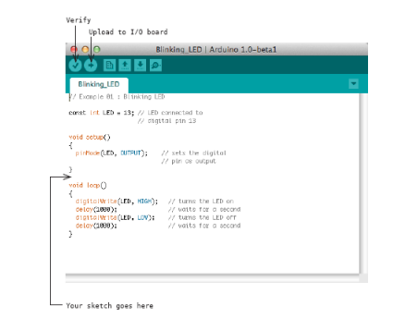
AGENDA
Introduction​
Primary goals
​Areas of growth
Timeline
​Summary​

Slide 3
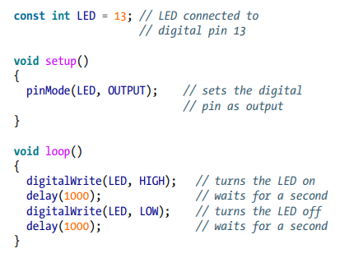
Introduction
At Contoso, we empower organizations to foster collaborative thinking to further drive workplace innovation. By closing the loop and leveraging agile frameworks, we help business grow organically and foster a consumer-first mindset.

Slide 4
The Code Explained
// - comment serves as our little notes
const int LED = 13;
const int means that LED is the name of an integer number that cannot be changed (a constant) whose value is set to 13.
void setup() - tells Arduino that the next block of code will be a function name setup()
pinMode() – tells Arduino how to configure a certain pin. A function and what is inside its parenthesis is called its arguments. Arguments are the information a function needs to do its job. Has two arguments: one tells which pin will be used, the other one tells whether it will be an INPUT or OUTPUT pin

Slide 5
The Code Explained
void loop() – where the main behavior of the interactive device is specified. It will be repeated
digitalWrite(LED, HIGH) – digitalWrite allows the turning off or on of any pin that is configured as output. Expects two arguments: (1) tells what pin is used and (2)tells whether to set the voltage level to 0 (LOW) or 5V (HIGH)
Delay(1000) – delays for a second

Slide 6
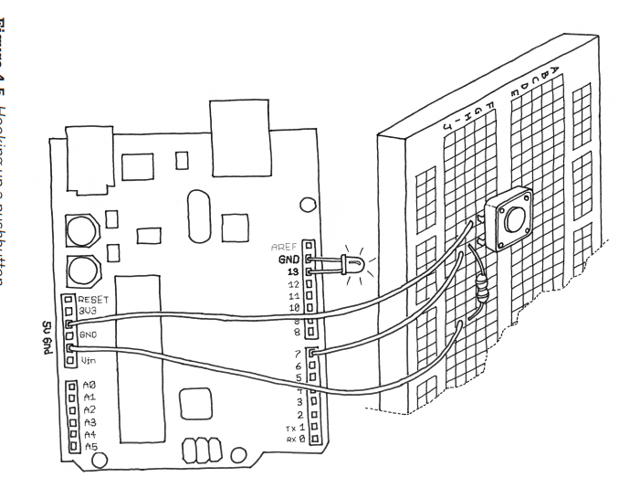

Slide 7
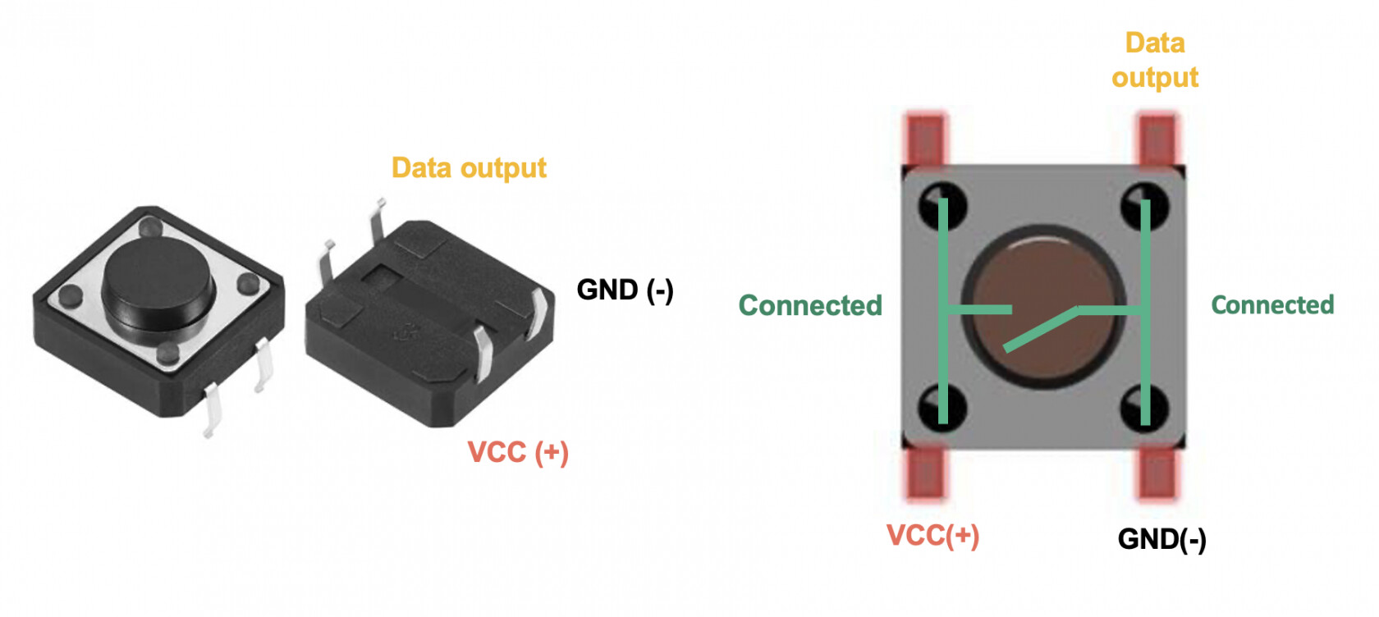

Slide 8
TURn on led while button is pressed
// Turn on LED while the button is pressed
const int LED = 13; // the pin for the LED
const int BUTTON = 7; // the input pin where the
// pushbutton is connected
int val = 0; // val will be used to store the state
// of the input pin
void setup() {
pinMode(LED, OUTPUT); // tell Arduino LED is an output
pinMode(BUTTON, INPUT); // and BUTTON is an input
}
void loop(){
val = digitalRead(BUTTON); // read input value and store it
// check whether the input is HIGH (button pressed)
if (val == HIGH) {
digitalWrite(LED, HIGH); // turn LED ON
} else {
digitalWrite(LED, LOW);
}
}

